Slide 1

Notes:
Welcome to the first unity lunch and learn.

Slide 2
Agenda
Overview
Features
Made with Unity
Scripting
Hands on exploring Unity
Coming up next
Notes:
We are going to start with the overview unity
- What is unity, the history of unity and which companies are using unity.
Next we are going to cover what is comparable to unity.
-We are going to talk about the Source Engine, Unreal Engine, and Cryengine.
Then we are going to talk about what was made with unity as well as show some demos of what was made.

Slide 3
Overview
History
General information
Supported Languages
Comparable Software
Notes:
-Unity Technologies was founded as Over the Edge Entertainment (OTEE) in Copenhagen in 2004 .
-Unity is updated 4 times a year each quarter of the year the software is maintained by Unity Technologies ApS and it is not community driven project it is a for profit platform helping development studios make games, tools and software.
Although the project is not open source it does have a large community of people willing to answer questions.
-Unity’s primary and only language for writing game scripts is C#. Starting with unity 2018.2 UnityScript which is unity’s version of javascript was removed.
-Unreal engine, Cryengine, Source Engine are all software comparable to unity.

Slide 4
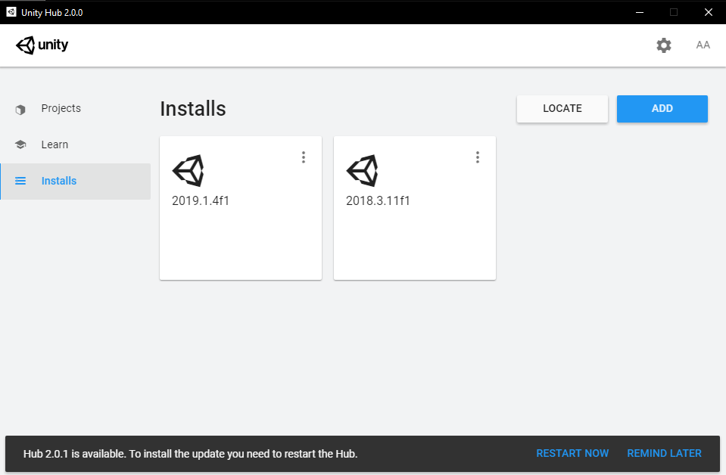
Features
Unity Hub
Notes:
-Unity offers a variety of features to help with game development;
-Unity Hub is one of those features. It is the central location where users can manage projects, versions of unity installed, and hear about new announcements and features.

Slide 5
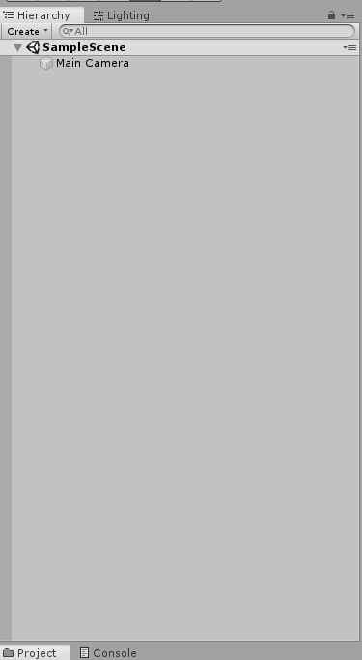
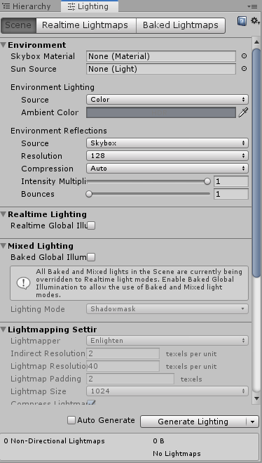
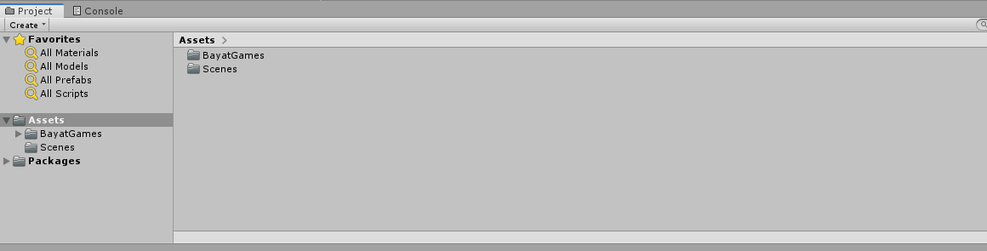
Features
Hierarchy Tree
Lighting Menu
Project Window
Notes:
The Hierarchy Tree shows a list of objects in the currently selected scene.
The Lighting menu is the main interface for unity’s Global Illumination system or (GI) for short. The GI system models how light interacts with the environment.
The project window view, allows a user to access and manage the assets that belong to selected project.

Slide 6
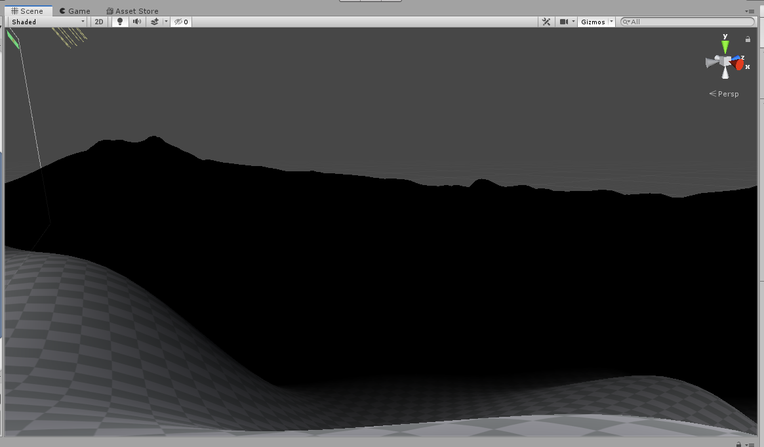
Features
Notes:
The next feature we are going to talk about is the Scene view navigation.
The top right tool is the Scene Gizmo. This tool tells you the orientation of the viewing angle and it also allows for quick rotations in your viewing angle by clicking on the cones.
The scene view navigation allows the user to view objects in the scene, to move the scene use the w,a,s,d keys and right click your mouse and move the mouse to rotate around the scene.

Slide 7

Made with Unity
Notes:
Here is a trailer of Ori and the Blind Forest Made with unity. And basically here I wanted to demonstrate what is possible with unity.
- This game is a 2D platform adventure game.

Slide 8
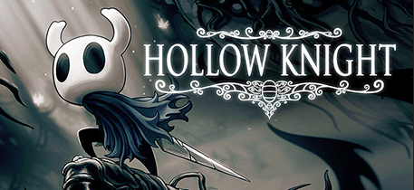
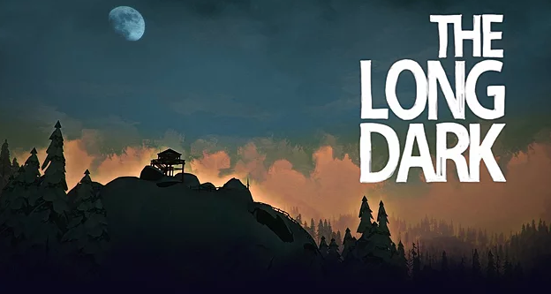
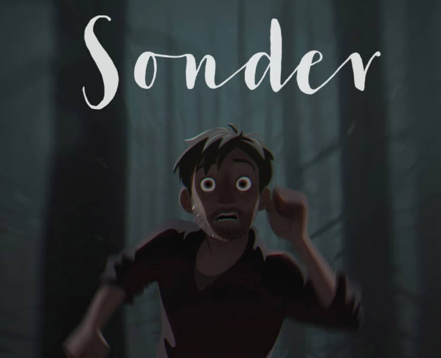

Made With Unity
Notes:
Here are some more games made with unity.
Hollow Knight is a 2D Adventure Platformer. The Long Dark is a survival adventure game. Rick and Morty Virtual Rick-Ality is a VR adventure game.
And Sonder is a Carton Series made with Untiy.

Slide 9
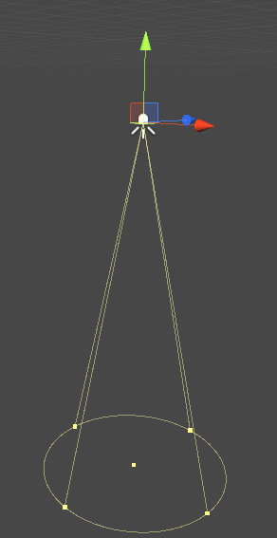
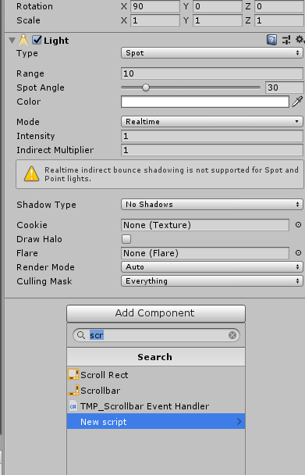
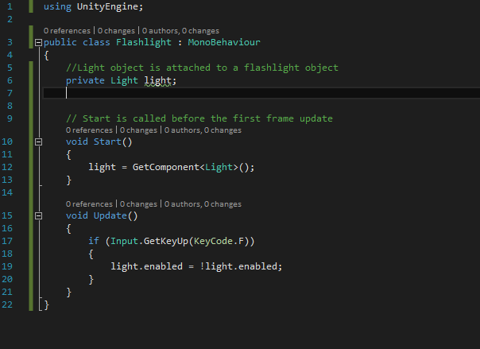
Scripting
Notes:
We are going to cover a simple script to learn the basics of C# scripting.
This is a simple script to turn a light on or off. This script is attached to a light object by selecting add component in the game inspector and selecting new script.
We need to use the start and update methods so we are going to inherit from the MonoBehavior class.
MonoBehaviour is the base class from which every Unity script derives.
The light object will be used because this controls all aspects of Unity's lights.
Start is called on the frame when a script is enabled before any of the Update methods are called.
Update is called every frame, if the MonoBehaviour is enabled.
Line 12, Using GetComponent will allow us to change the enabled bool to true or false.
Line 17, Listens for the F button keypress.
Line 19, sets enabled to the opposite of what was previously set.
***Side note: Flashlight is the derived class.

Slide 10
Exploring Unity…
Notes:
When exploring unity the objective is going to be create a
- Explain camera control.
Explain creating an object
Talk about asset store
Maybe create a simple terrain

Slide 11
Coming Up Next…
Notes:
We will be looking at how to create a platformer game next Lunch and Learn.

